Slide 1
Case study: Document similarity
Computational thinking

Slide 2
Document similarity problem
Determine if two text documents are similar in content

Slide 3
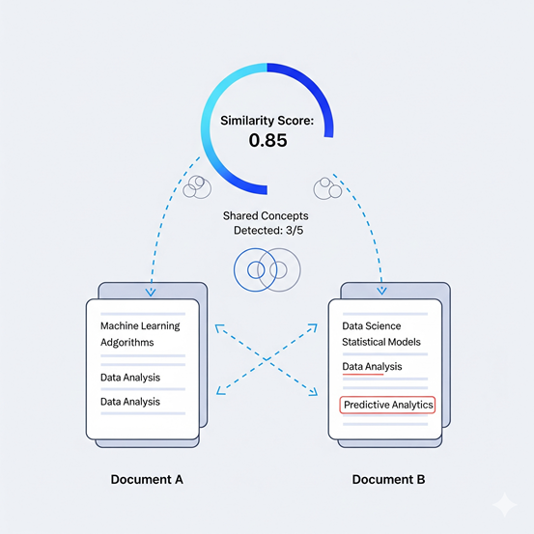
Problem analysis
ill-defined: Are these two texts similar?
Well-defined:
Input: Two text documents
Output: Similarity score (0–1) or decision (similar vs. not similar)
Goal: Analyze similarity based on word usage, meaning, or structure

Slide 4
Decomposition
1. Preprocess documents (cleaning, tokenization)
2. Convert text into numeric representation (vectorization)
3. Calculate similarity
4. Output result (score or label)

Slide 5
Pattern recognition
Similar documents share:
Common words or phrases
Semantic meanings (e.g., 'cat' and 'feline')
Similar structures
Techniques:
Cosine similarity (vector-based)
Jaccard similarity (set overlap)
Semantic models for deep meaning

Slide 6
Abstraction
Represent documents as:
Bag-of-words vectors
TF-IDF vectors
Embeddings (e.g., BERT)
Ignore formatting, exact word order
Focus on features representing meaning

Slide 7
Algorithm design
Simple version:
- Use TF-IDF vectorization
- Compute cosine similarity
Advanced version:
- Use transformer embeddings (BERT)
- Cosine similarity in embedding space
Pseudocode:
def compute_similarity(doc1, doc2):
vec1 = encode(doc1)
vec2 = encode(doc2)
score = cosine_similarity(vec1, vec2)
return score

Slide 8
Simulation / Implementation
Python Example (TF-IDF + cosine):
from sklearn.feature_extraction.text import TfidfVectorizer
from sklearn.metrics.pairwise import cosine_similarity
tfidf = TfidfVectorizer().fit_transform([doc1, doc2])
score = cosine_similarity(tfidf[0], tfidf[1])
With BERT (SentenceTransformers):
from sentence_transformers import SentenceTransformer, util
model = SentenceTransformer('all-MiniLM-L6-v2')
embeddings = model.encode([doc1, doc2])
score = util.cos_sim(embeddings[0], embeddings[1])

Slide 9
Testing & Improvement
Test with:
Identical content → high similarity
Paraphrased content → still similar
Unrelated content → low similarity
Improve with:
Stemming/lemmatization
Robust semantic models (fine-tuned BERT)
Combine lexical + semantic measures

Slide 10
Conclusion
Document Similarity illustrates CT:
Decomposition: raw text → score
Abstraction: text → vectors
Pattern Recognition: lexical & semantic overlap
Algorithm Design: vector models + similarity metrics
Applications: plagiarism detection, search engines, clustering

Slide 11
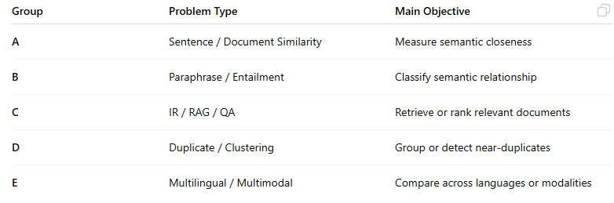
Types of problem
Text Similarity / Semantic Matching / Information Retrieval

Slide 12
Similar problems

Slide 13
01. Sentence / Semantic Textual Similarity
Goal: Measure how similar two sentences are in meaning
Difference: A narrower version of document similarity at the sentence level
Example: “He is eating an apple.”
vs “A man is having fruit for lunch.”
→ Similarity ≈ 0.8
Applications: Paraphrase detection, question similarity, query expansion

Slide 14
02. Paraphrase Identification
Goal: Determine whether two texts express the same idea.
Example: “Obama was born in Hawaii.”
vs “Hawaii is Obama’s birthplace.”
→ True
Difference: A binary classification form of document similarity.
Famous datasets: Quora Question Pairs, Microsoft Research Paraphrase Corpus (MSRP)

Slide 15
03. Textual Entailment / Natural Language Inference
Goal: Check whether one text logically entails another
Example:
Premise: “A man is riding a bicycle.”
Hypothesis: “A man is outdoors.”
→ Entailment (B follows from A)
Difference: Goes beyond similarity by identifying Entail / Contradict / Neutral relations

Slide 16
04. Information Retrieval (IR) / Document Ranking
Goal: Rank documents according to their relevance to a query
Relation: Document similarity serves as a core component of IR systems.
Example:
Query: “Best machine learning libraries in Python.”
Documents: (A) TensorFlow blog, (B) PyTorch blog, (C) Scikit-learn tutorial
→ Rank by query–document similarity

Slide 17
05. Duplicate or Near-Duplicate Document Detection
Goal: Detect identical or nearly identical documents (useful for web indexing or plagiarism)
Techniques: MinHash, SimHash, Locality-Sensitive Hashing (LSH)
Example: Detecting two news articles that share 95% of their content

Slide 18
06. Topic Similarity / Document Clustering
Goal: Group documents by similar topics or themes.
Example: Cluster documents about “deep learning,” “neural networks,” and “AI applications.”
Technique: Represent documents as vectors (TF-IDF, Doc2Vec, BERT embeddings) and compute cosine similarity.

Slide 19
07. Cross-Lingual Document Similarity
Goal: Match equivalent documents across languages.
Example:
“Climate change impacts agriculture.” (English)
“Biến đổi khí hậu ảnh hưởng đến nông nghiệp.” (Vietnamese)
→ High similarity
Techniques: Multilingual embeddings (mBERT, LaBSE, LASER, etc.)

Slide 20
08. Query–Passage Matching (in QA Systems / RAG)
Goal: Retrieve the passage most relevant to a user query.
Example:
Query: “Who discovered penicillin?”
Passage: “Alexander Fleming discovered penicillin in 1928.”
→ High similarity score.
Applications: Retrieval-Augmented Generation (RAG), open-domain question answering.

Slide 21
09. Summarization Consistency Checking
Goal: Compare a generated summary with the source text to verify faithfulness.
Example:
Summary: “The study confirms that AI improves accuracy.”
Original: “The study suggests AI may improve accuracy.”
→ Low factual similarity.

Slide 22
10. Graph / Knowledge-Based Document Similarity
Goal: Compare documents using semantic graphs (entities and relationships)
Techniques: Build entity-relation graphs, then compute graph similarity
Applications: Semantic search, entity linking, ontology matching

Slide 23
11. Code or Multimodal Similarity
Text-to-Code Similarity: Match source code snippets to natural language descriptions
Text–Image Similarity (CLIP-style): Match images to textual captions
→ These extend document similarity into multimodal domains.

Slide 24
12. Metric Learning / Siamese Network Problems
Goal: Learn an embedding function that places similar documents close in vector space.
Example Models: Siamese BERT, Sentence-BERT (SBERT), Contrastive Learning.

Slide 25
Applications into
Smart travel system

Slide 26
01. Travel Recommendation (Destination Similarity)
Use document similarity to find destinations with similar descriptions
Example: User liked a blog or review about “Da Nang beach activities”.
System searches for other documents with high similarity (e.g., “Phu Quoc snorkeling spots”, “Nha Trang diving tours”).
Techniques:
Represent destinations using TF-IDF, Doc2Vec, or Sentence-BERT embeddings.
Compute cosine similarity between destination descriptions.

Slide 27
2. User Query Understanding
Compare the user’s query with travel content in your database.
Example:
Query: “romantic places for honeymoon in winter”
→ System retrieves destinations with semantically similar descriptions.
Models:
SBERT / SimCSE / MiniLM for semantic embeddings.
Use vector database (FAISS, Weaviate, Pinecone) for fast similarity search.

Slide 28
3. Review and Comment Analysis
Cluster or detect similar reviews using document similarity
Merge duplicate reviews.
Detect spam or copy-paste content.
Identify trending topics among traveler reviews.

Slide 29
4. Itinerary or Package Matching
Given a user’s planned itinerary (a text description), find similar existing travel packages.
Example:
User itinerary: “3-day trip to Da Lat with trekking and waterfall visits.”
→ Retrieve similar tour packages using semantic similarity.

Slide 30
5. Personalized Content Matching
When a user reads or saves a travel article, the system recommends semantically similar content.
Pipeline:
Encode each document (destination info, blog, review) → vector.
Encode the user’s currently viewed document → vector.
Retrieve top-k similar vectors using cosine similarity.

Slide 31
6. Multilingual Support
If your system supports multiple languages, use cross-lingual embeddings (LaBSE, mBERT) to match English and Vietnamese travel content.

